Slide 2
Freedom Park School
Principal - Dr. Titania Singh
Assistant Principal – Ms. Amanda Darville
Assistant Principal – Ms. Wendy May

Slide 3
Bullying: No Bullying. It’s the Law.
Bullying behavior is defined as any pattern of written or verbal expression or any physical act or gesture that is intended to ridicule, humiliate, intimidate, or cause measurable physical or emotional distress upon one or more students:
A student shall not do, attempt, or threaten to bully any person, including students and employees:
a) In the school
b) On school grounds
c) In school vehicles (including school buses)
d) At school bus stops
e) Or at school activities or sanctioned events
A third instance of bullying in a school year would require that the student be assigned to an alternative educational setting. However, the principal or other appropriate designee may recommend the Alternative Center or suspension, in her discretion prior to the third offense.
*FOR PRE-K – 5 REFER TO RULES 23 AND 24 (RCBOE CODE OF CONDUCT)
*FOR 6 -12 DISCIPLINE OPTIONS, REFER TO RULES 23, 24, &amp;27 (RCBOE CODE OF CONDUCT)
Code of Discipline for Freedom Park School
Students are expected to display admirable Character Traits at all times. They are representative of their family, school

Slide 4
Attendance Policy
Students are expected to be in school all day unless they are ill. Georgia State law only recognizes absences due to illness, religious holidays, medical or legal appointments, and funerals in the family. Parents have the right to present reasons they believe are justifiable to the Principal for consideration of other absences.
All absences require a written note from parents/guardians stating the reason for the absence. Emailed notes will not be accepted. A note without a reason and date of absence is unexcused. The note must include the student's full name, reason for absence, date(s) of absence, and parent/guardian signature.
In order to comply with district regulations and state law, when a student has 10 unexcused absences in one month or ten unexcused absences in one year, Richmond County administrators will petition the Juvenile Court System to seek mandatory attendance by a student. An unexcused absence is defined as any unauthorized absence from school. Examples include, but are not limited to:
1. Hair appointments 2. Oversleeping
3. Shopping 4. Missing the bus
5. Concerts 6. Babysitting
7. Failure to obtain private transportation to school 8. Mechanical problem
9. Failure to obtain leave of Absence request for absences

Slide 5
Title 1
Freedom Park School is a Title I school. This means we are provided financial assistance through the Every Student Succeeds Act, Part A. Its overall purpose is to ensure that all students have a fair and equal opportunity to obtain a high-quality education and reach, at a minimum, proficiency on state assessments (i.e. GA Milestones, End-of-Course, etc.), as well as involve parents in their child's education.
There will be an upcoming Title I Annual Parent Meeting which will outline parent involvement opportunities - you will be sent meeting information via FPS's ClassDojo account later in the school year.
If you have any questions, please contact the FPS Title I Parent Facilitator

Slide 6
Tardy​ Policy
Students are not allowed on campus prior to 6:50 a.m. Any student reporting to the classroom after 7:25 a.m. is tardy. A parent must sign in tardy students.
The accumulation of unexcused tardies may warrant disciplinary action and/or referral to
Department of Family and Children Services.
Leaving school for unauthorized purposes before the end of the instructional day will be counted as a tardy.
Parents should not pick their children up before the end of the school day except where there is a legitimate emergency. Lawful excuses for tardiness are cited in the RCSS Code of Student
Conduct and Discipline.
For the safety of our students during dismissal transition, we will not allow building entry starting at 1:55 pm until 2:10pm.

Slide 7
School Lunches
Breakfast starts and 6:50 am and is free for all students. Breakfast ends at 7:20
* Please fill out school meal applications for the lunch meal. Please visit the lunchroom to apply.
MySchoolBucks
Free/Reduced Meal Applications

Slide 8
Meet the 1st Grade Teachers
Mrs. Fagan RM 111
Ms. Frails RM 112
Mrs. D Smith RM 110
Mrs. Thomas RM 108
I

Slide 9
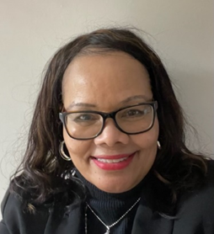
Meet Ms. Fagan
I have been an Educator for 20 years.
I have a Bachelor of Science, from University of Alabama in Early Childhood and a Master of Science in Integrating Technology in the Classroom from Walden University.
I have a son and a grandson. I enjoy Reading, Golf, Tennis, and Music.
I look forward to an exciting school year.
I

Slide 10
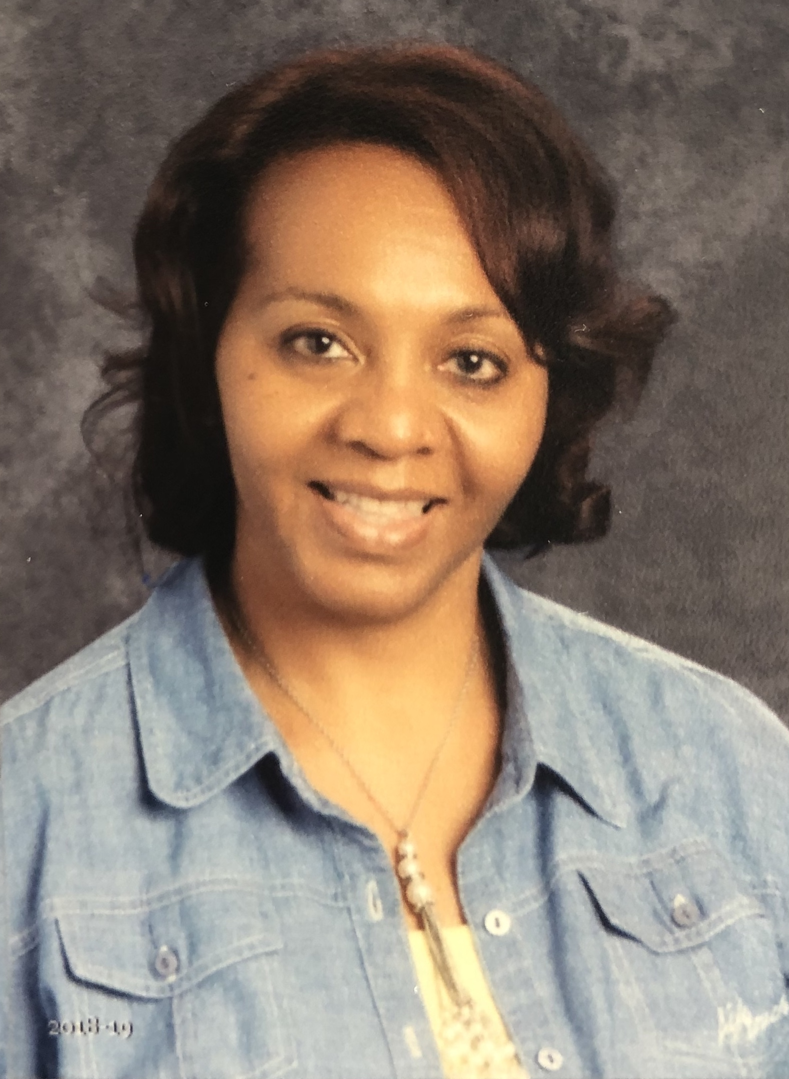
Meet Ms. Frails
I attended Paine College, with a Bachelors in Elementary education.
Attended Troy State University, with a Masters in Instructional Technology.
Continued my academic career at Cambridge University, with a specialist degree in Educational Leadership Administration.
I have 3 boys that are 30, 21, 16.
I have been teaching at Freedom Park for 18 years.

Slide 11
Meet Mrs. Smith
I was born and raised in Ridge Spring, SC.
I come from a large family with seven brothers and one sister.
I graduated from USC-Aiken with a bachelor's degree in elementary education.
I have taught for 17 years, grades 1-4.
My hobbies include reading, watching movies, gardening, and ballroom dancing (mostly salsa dancing).
I am also a broker of my own real estate company, Above Grade Realty, LLC. I enjoy helping others to buy and sell homes.
I enjoy teaching, and I look forward to a productive and successful school year!!

Slide 12
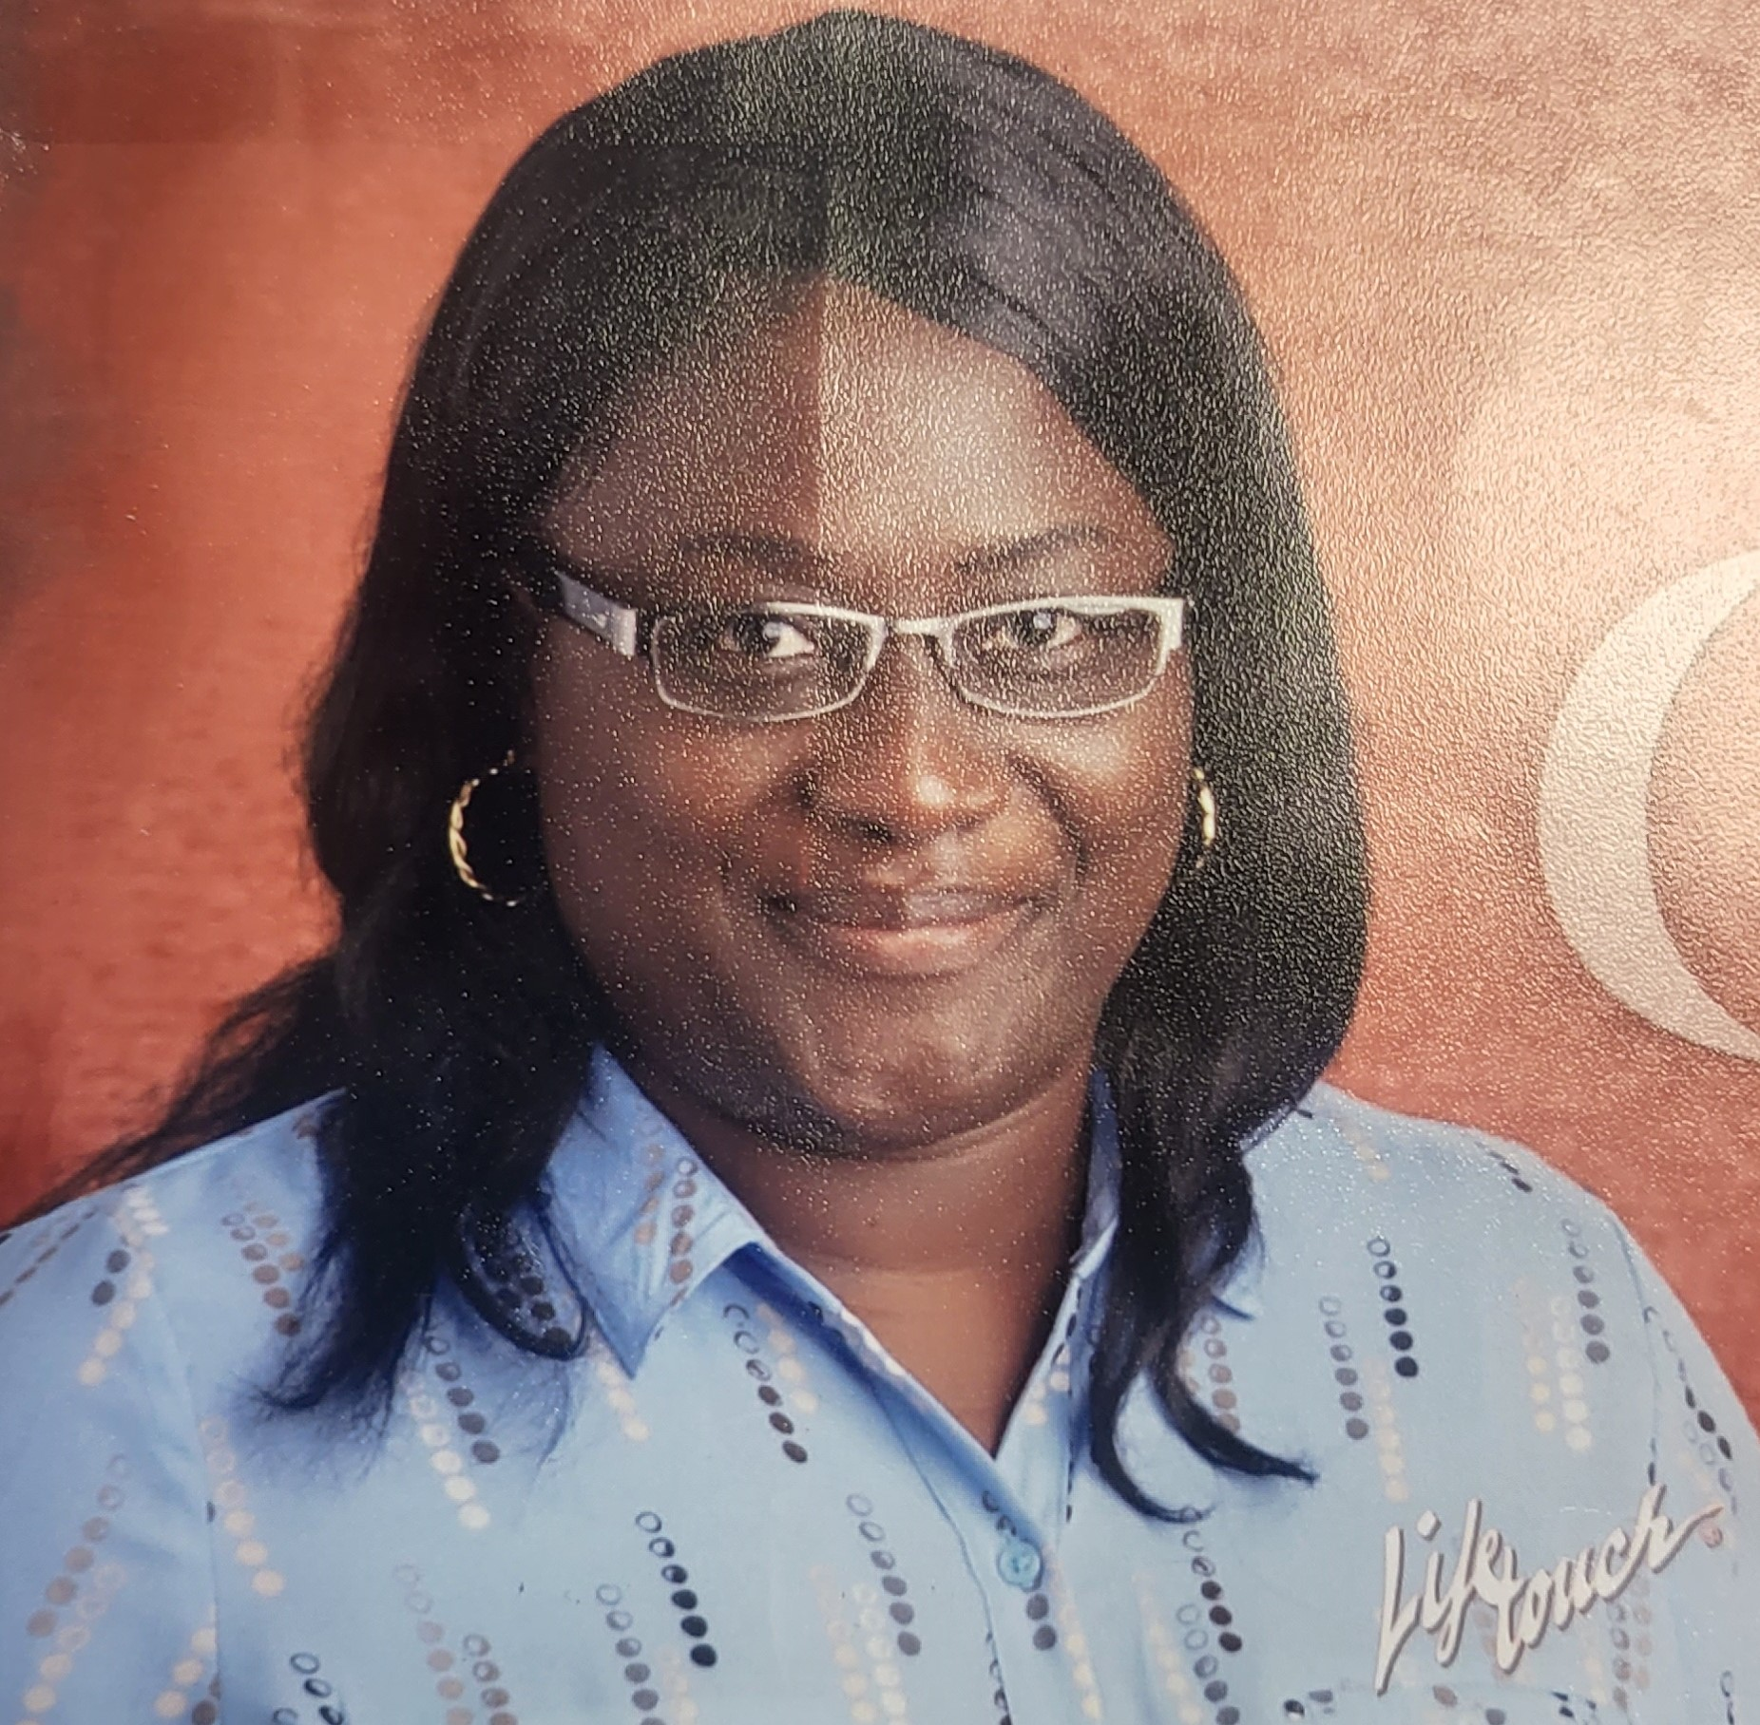
Meet Mrs. Thomas
I am a retired US Army veteran.
I received my undergraduate and Bachelor's degree in Early Childhood Education and a Master in Education from Ashford University.
I am married with two kids, a grand child and two fur babies( Ginger & Tucka).
I enjoy spending time with family.

Slide 13
School Hours Breakfast- 6:50 am Instruction Begins- 7:25 am Dismissal- 2:15 pm

Slide 14
Arrival and Dismissal
All First Grade Students will report to the big gym at 6:50 am. The door to the big gym is at the back of the school.
Bus riders will arrive and dismiss through the front of the school.
Car riders will be given a number. Please write this number down and display it on the dashboard of your car for dismissal. Please also ensure your child knows their car rider number.
Dismissal begins at 2:15 pm. Please pick your child up on time! After 2:30pm your child will be in the front office. You will then have to come inside to sign them out.

Slide 15
Class Dojo
Our primary contact is through Class Dojo. You can access dojo online or download the app.
On Class Dojo you will see the class story page where important information and reminders will be posted. There is also a separate private messaging tab as well.
You will also be connected to the Freedom Park school story page where you will be updated with school information.

Slide 16
First – Grade Curriculum
Phonics- Fundations
ELA- Benchmark Literacy
Math- iReady Math
Science- Georgia Science
Social Studies- Social Studies Weekly

Slide 17
iReady
Our students will be using iReady.
iReady consists of individualized learning modules, learning games, assessments, and diagnostics to track your child’s progress in their learning.
Teachers will assign iReady lessons to be completed as homework on Tuesdays and Thursdays.

Slide 18
First-Grade Homework
Daily- Reading Log & Sight Words Choice Board
Monday- Math & Reading handout
Tuesday- iReady Teacher assigned Reading lesson
Wednesday- Math & Reading handout
Thursday- iReady Teacher assigned Math lesson
Friday- No Homework

Slide 19
First –Grade Connections
Students will rotate daily between 5 connections. Each class will have their own connections schedule.
Music
PE- Tennis shoes are required
Spanish
Computer- Headphones are required (over the head kind)
Art

Slide 20
Water Bottles and Snack
Please send in a reusable water bottle with your child's name on it and a healthy snack daily.
Students will only be allowed to drink water in the classroom. Please NO juices, sodas, sports drinks, or flavored water.
We will have snack daily.
Please no candy, cookies, cakes, or sugary treats.
Healthy snacks are highly recommended.
PLEASE NOTIFY your child teacher If there are any student allergies.

Slide 21
What you will love about 1st Grade
Fun Projects
Interactive Notebooks
Field Trips (TBD)
The Treasure Box ☺
Tremendous Growth!

Slide 22
1st Grade Daily Schedule
6:50-7:20 | Arrival in big GYM, Breakfast in classroom
7:25-8:00 | Morning Work, Intervention
8:00-10:10 | Phonics, Reading, Writing
10:10-10:40 | Recess
10:40-11:20 | Lunch
11:20-12:00 | Math
12:00-12:40 | Connections
12:40-1:15 | Math
1:15- 2:10 | Social Studies/Science
2:15-2:30 | Dismissal

Slide 23
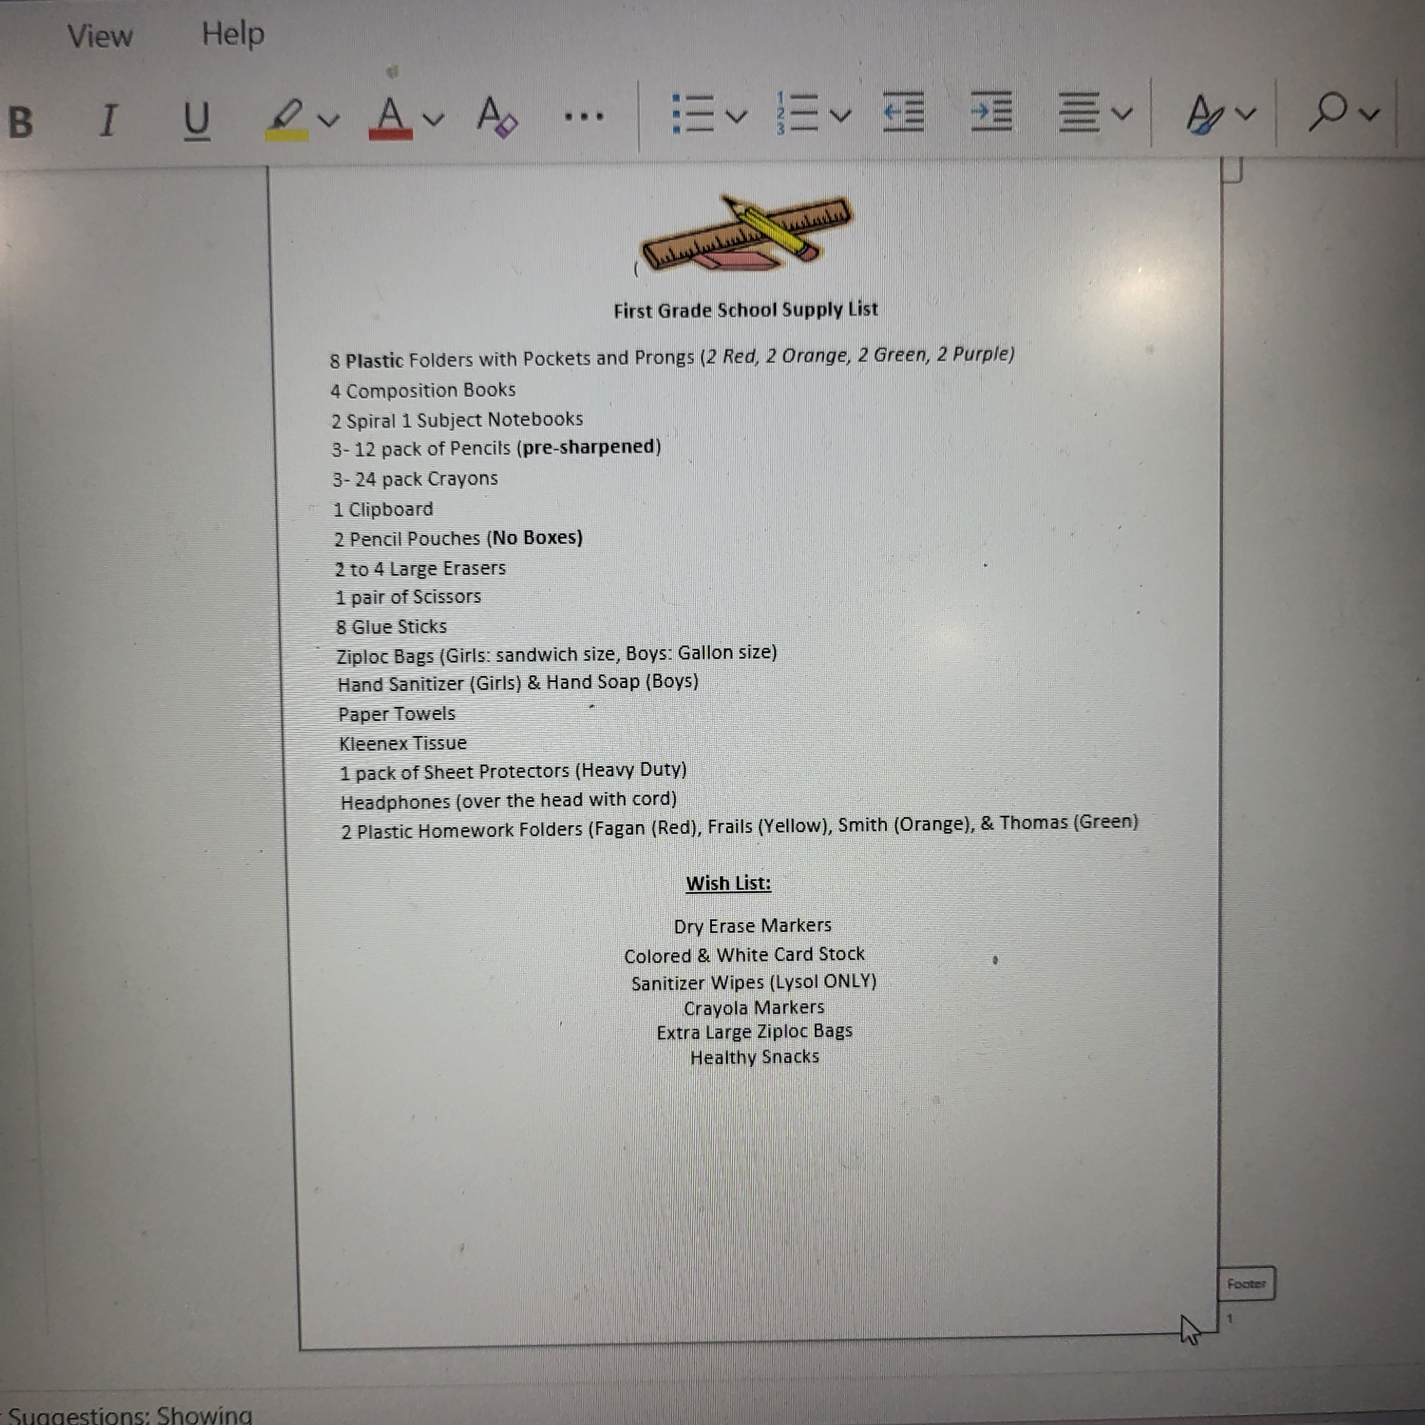
School Supply List

Slide 24
Questions? Feel free to communicate with your child's TEACHER

Slide 25
We cannot wait for this year to get started! Aug 7th

